Slide 1
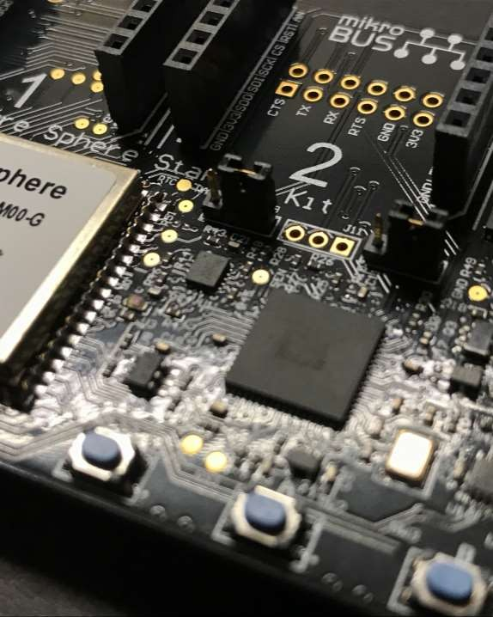

Agenda
Lambda Architecture Azure Stream Analytics

Slide 2
Lambda Architecture
Data aggregation design patter
Real-Time Processing / Analytics
Fast / Hot path
Batch Processing
Slow / Cold Path

Slide 3





Lambda Architecture
Action
IoT Devices
Real-Time (Hot)
Stream Processor
Broker
Storage
Batch (Cold)

Slide 4
Lambda Architecture
Action
Azure Functions
Broker IoT Hub Event Hub
Stream Processor Stream Analytics HDInsight Spark Streaming
Storage Cosmos DB SQL Database Service Bus
Azure Data Lake

Slide 5

Azure Stream Analytics
Real-time stream processing
Stream millions of events per second
Multiple Input and Output Streams
Familiar SQL-like language
Serverless

Slide 6
Stream Analytics Data Flow
Processing
Data Output(s)
Data Stream(s)

Slide 7








Azure Stream Analytics in the Cloud
Ingest
Analyze Deliver
Alerts and actions
Event Hubs, Service Bus, Azure Functions etc.
IoT Devices
Continuous Intelligence/ Real-time analytics
Dynamic Dashboarding
Power BI
Logs, Files, Media
Data Warehousing
SQL Data Warehouse
Customer data, Financial Transactions
Kafka
Storage / Archival
SQL DB, Azure Data Lake Gen1 and Gen 2,
Cosmos DB, Blob Storage etc.
Weather data
Reference Data
(SQL DB, Blob store)
Real-time scoring
(Azure ML service)
Business Applications

Slide 8
Stream Analytics Inputs
Data Stream
Azure IoT Hub
Azure Event Hub
Reference Data
Azure Blob Storage
Azure SQL Database

Slide 9
Stream Analytics Outputs
Cosmos DB
SQL Database
Azure Table Storage
Azure Service Bus
Power BI
Azure Data Lake

Slide 10
Stream Analytics Query
Perform processing on data stream
Stream Analytics Query Language
SQL-like language
SELECT
*
INTO
[YourOutput] FROM
[YourInput]

Slide 11
Stream Analytics Query
Aggregate
AVG, COUNT, Collect, CollectTOP, MAX, MIN, Percentile_Cont, Percentile_Disc, SUM, TopOne, VAR
Analytic
ISFIRST, LAG, LAST
Array
GetArrayLength, GetArrayElement, GetArrayElements
Conversion
CAST, GetType, TRY_CAST
Geospatial
CreateLineString, CreatePoint, CreatePolygon
Date and Time
DATEADD, DATEDIFF, DATENAME, DATEPART, DAY, MONTH, YEAR
Mathematical
ABS, CEILING, EXP, FLOOR, POWER, SIGN, SQUARE, SQRT
Record
GetRecordProperties, GetRecordPropertyValue
String
CONCAT, LEN, LOWER, UPPER, SUBSTRING, REGEXMATCH

Slide 12
Window Functions
Temporal Window Functions
TumblingWindow
HoppingWindow
SlidingWindow

Slide 13
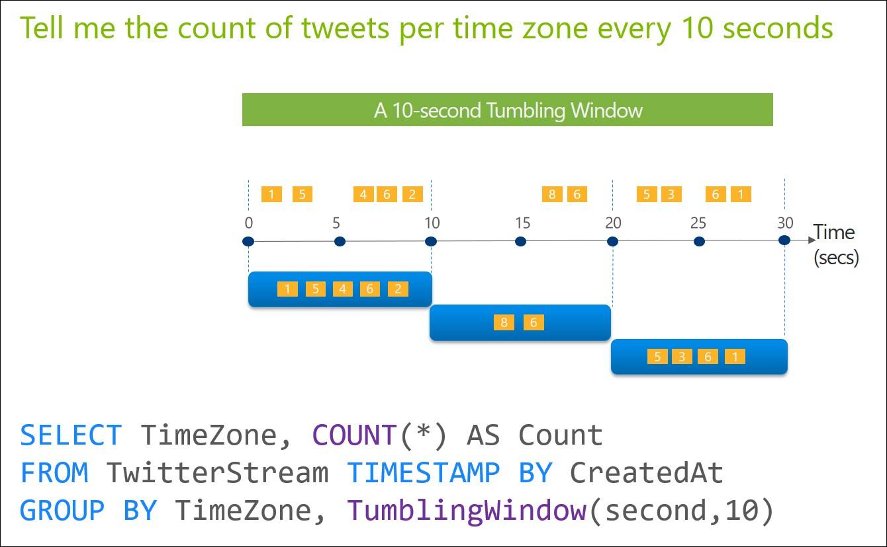
Tumbling Window

Slide 14
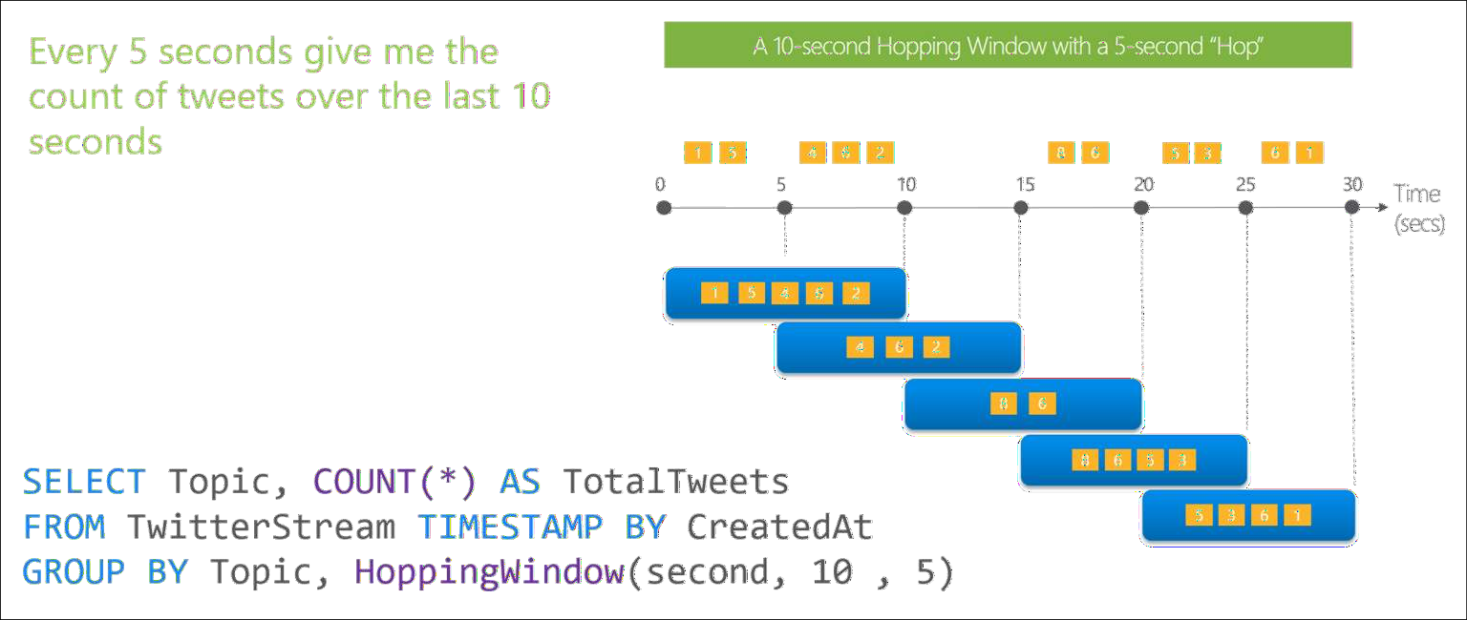
Hoping Window

Slide 15
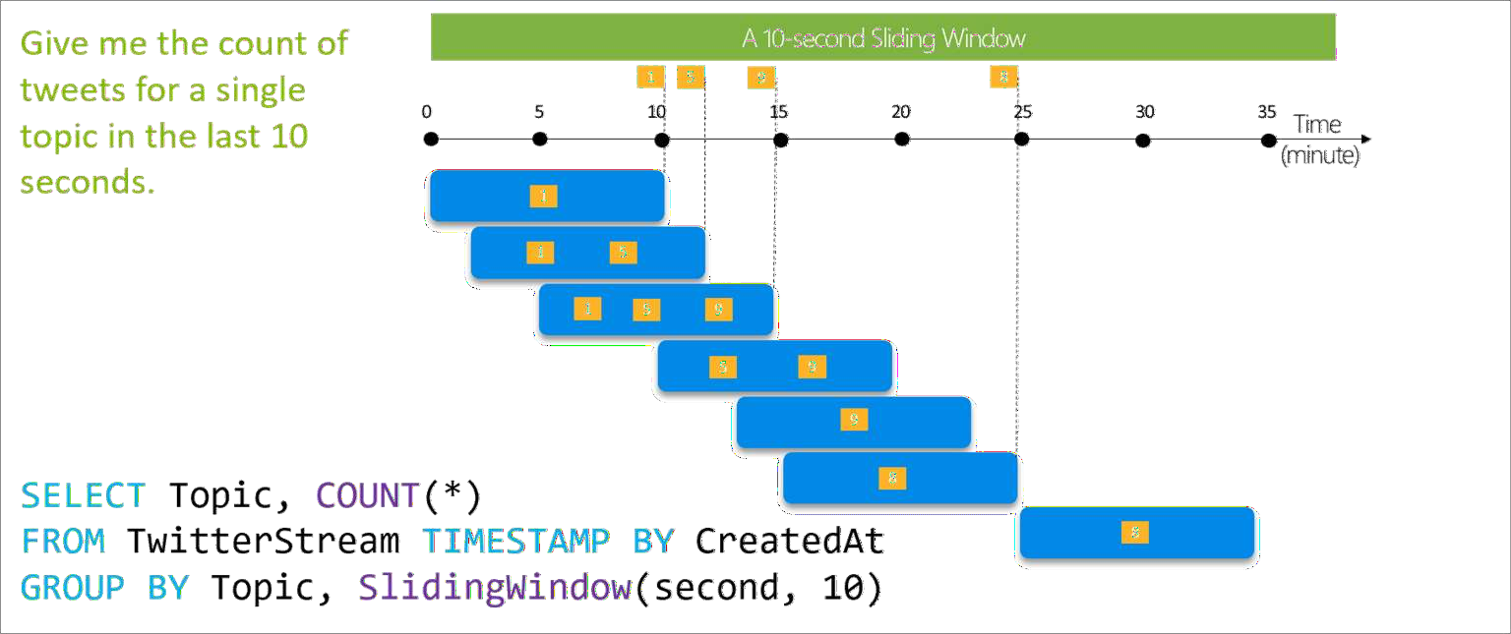
Sliding Window

Slide 16
Functions
JavaScript UDF (user defined functions)
// Convert Hex value to integer.function hex2Int(hexValue) {
return parseInt(hexValue, 16);
}
SELECT time, UDF.hex2Int(offset) AS IntOffset
INTO output
FROM InputStream

Slide 17
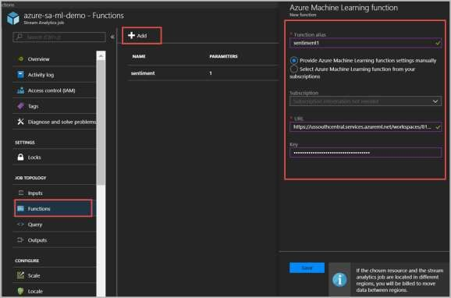
Functions
Integrate Azure Machine Learning
WITH sentiment AS (
SELECT text, sentiment1(text) as result FROM datainput
)
SELECT text, result.[Score] INTO datamloutput FROM sentiment

Slide 18
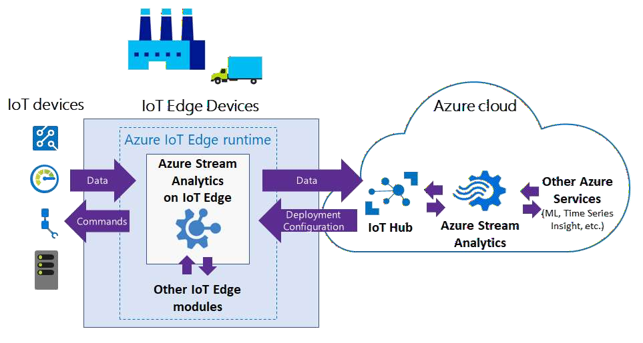
Azure Stream Analytics on IoT Edge

Slide 19
Azure Stream Analytics on IoT Edge
Industrial IoT
Too much data to upload to cloud
Send aggregate, average, or only “significant” events where values changed
Examples:
Jet Engines – single flight can produce 1TB of data
Manufacturing – sensors can produce 1MB/s to 10MB/s of event data

Slide 20
Demo
Setup Azure Stream Analytics Input from Azure IoT Hub
Output to Cosmos DB and Azure Functions Setup Lambda Architecture

